Slide 1
Blood Findr
Lord Caguiat
Enrico Gloria
Vince Nato
Sean Magalong

Slide 2
Introduction:

Slide 3
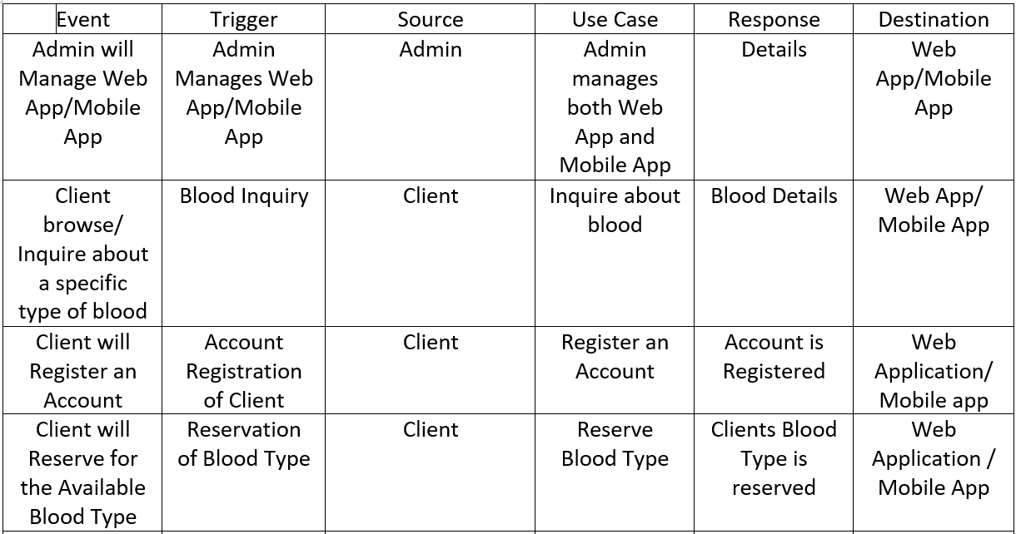
Event Table:

Slide 4
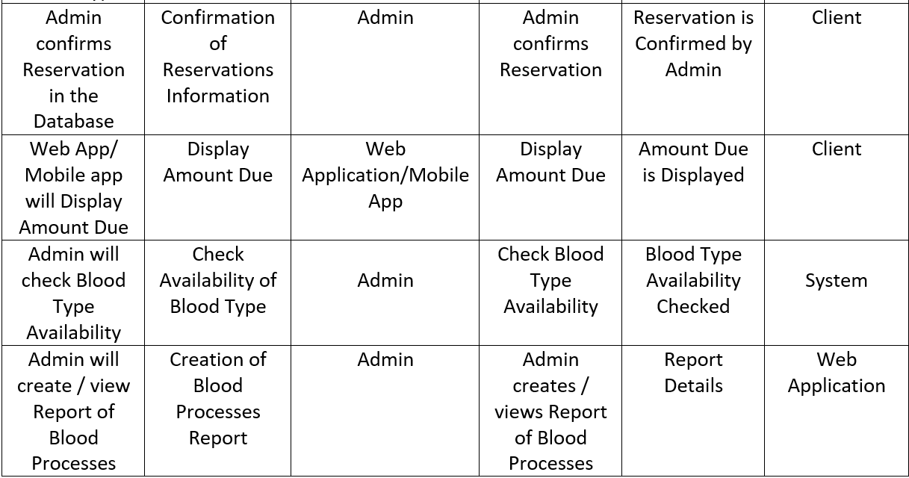
Event Table (cont.):

Slide 5
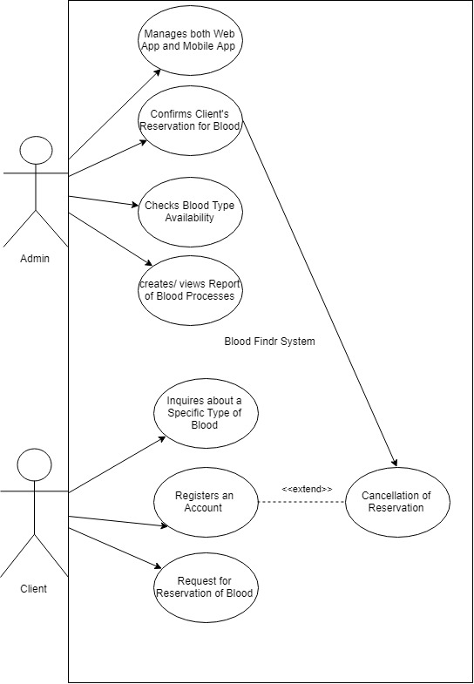
Use Case Diagram:

Slide 6
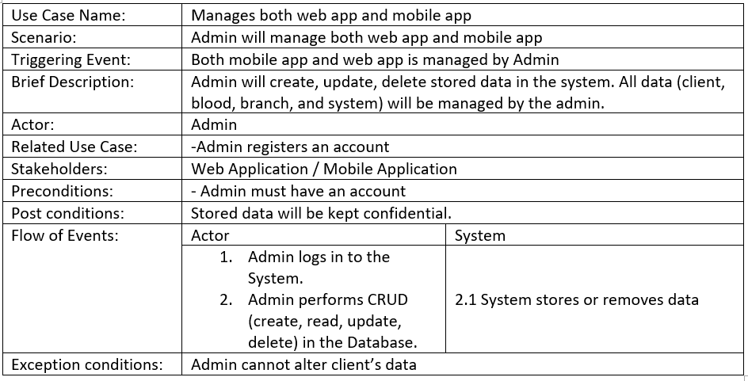
Use Case Full Description:

Slide 7
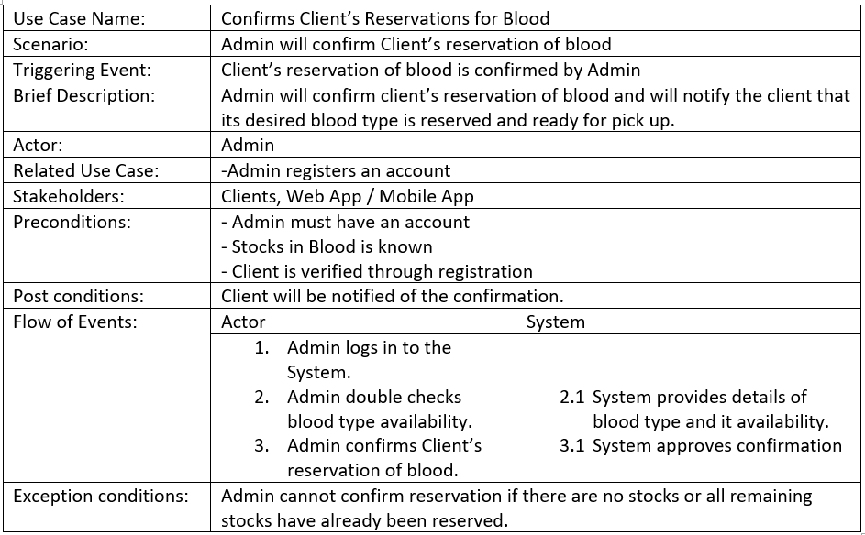
Use Case Full Description (cont.):

Slide 8
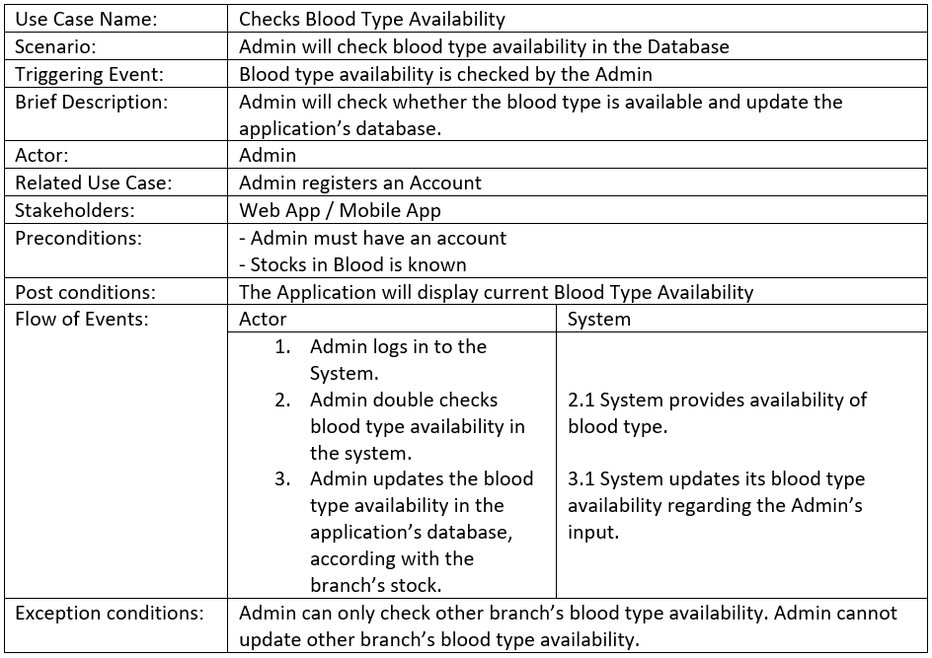
Use Case Full Description (cont.):

Slide 9
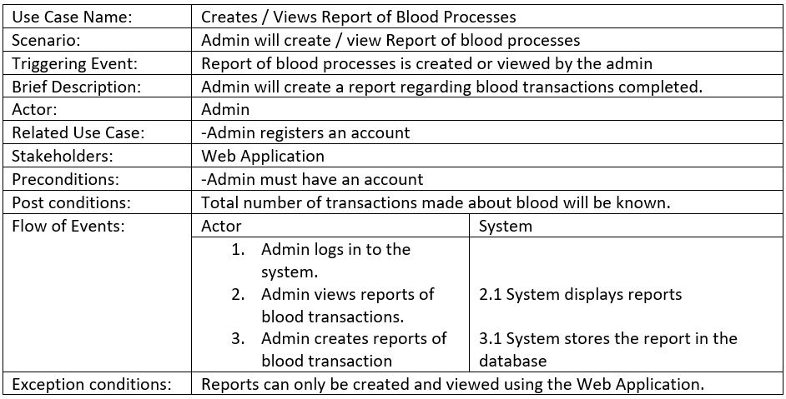
Use Case Full Description (cont.):

Slide 10
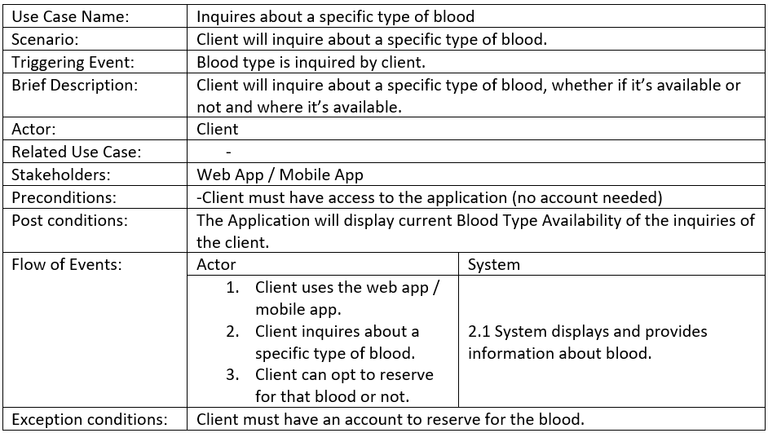
Use Case Full Description (cont.):

Slide 11
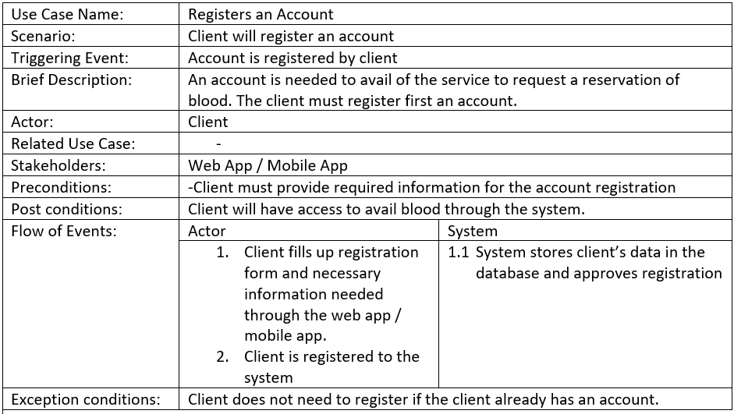
Use Case Full Description (cont.):

Slide 12
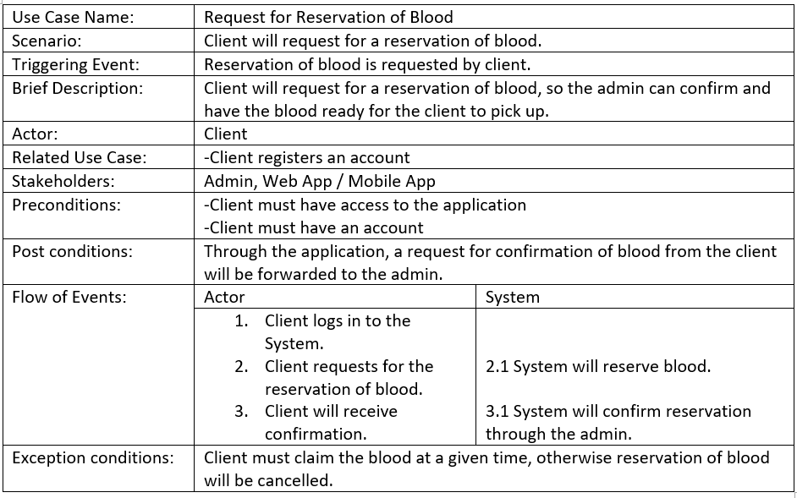
Use Case Full Description (cont.):

Slide 13
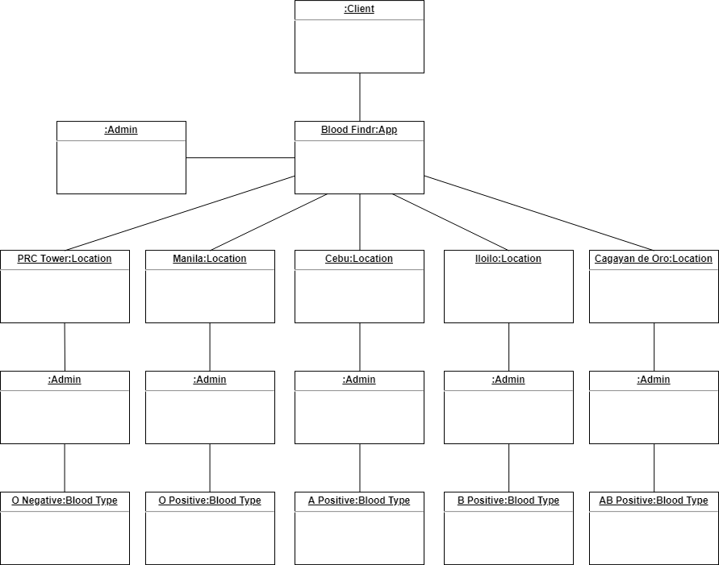
Object Diagram:

Slide 14
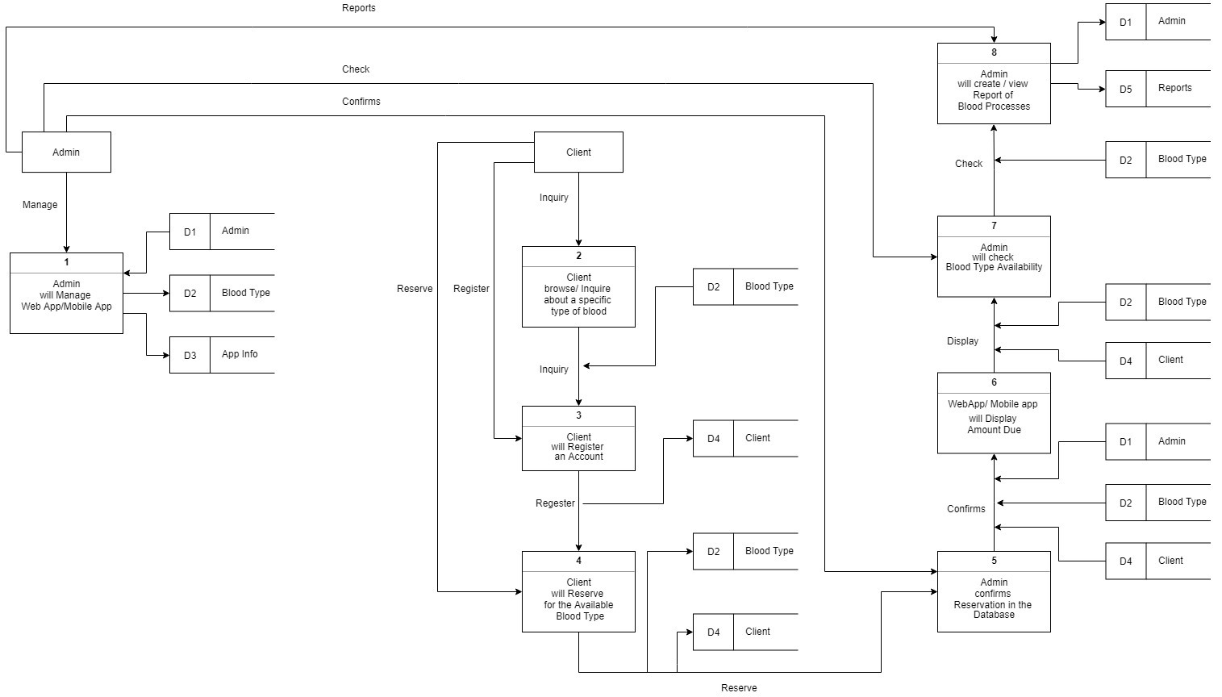
Data Flow
Diagram:

Slide 15
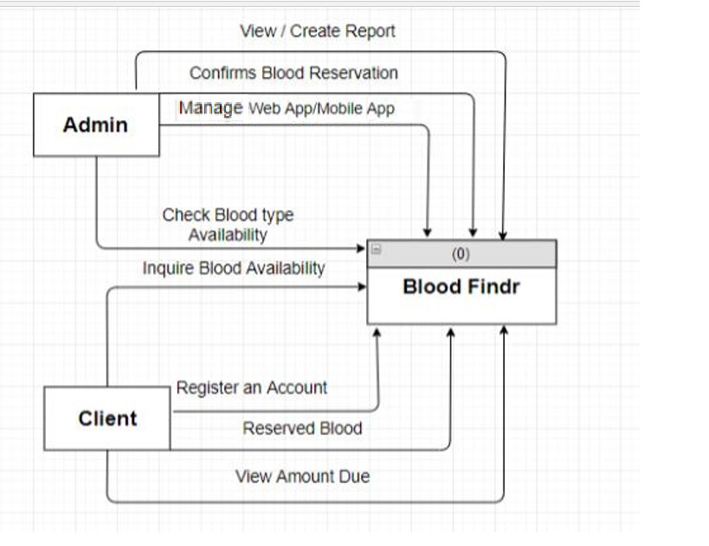
Context Flow
Diagram:

Slide 16
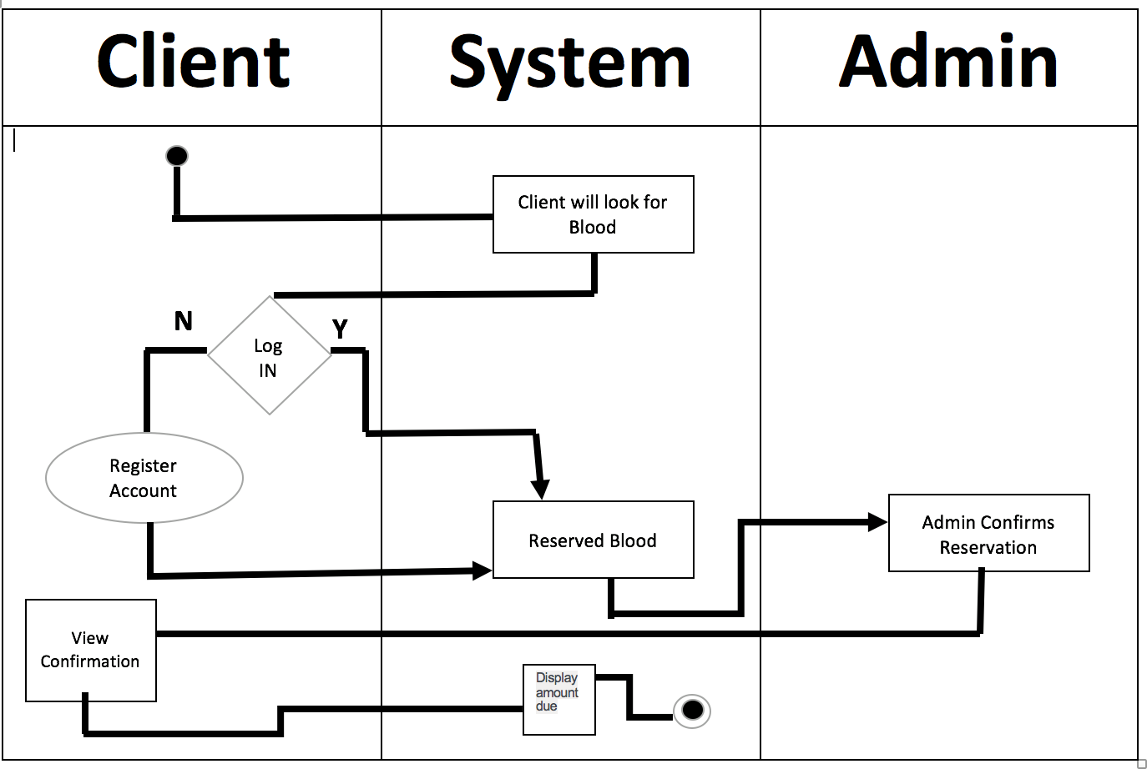
Activity Diagram:

Slide 17
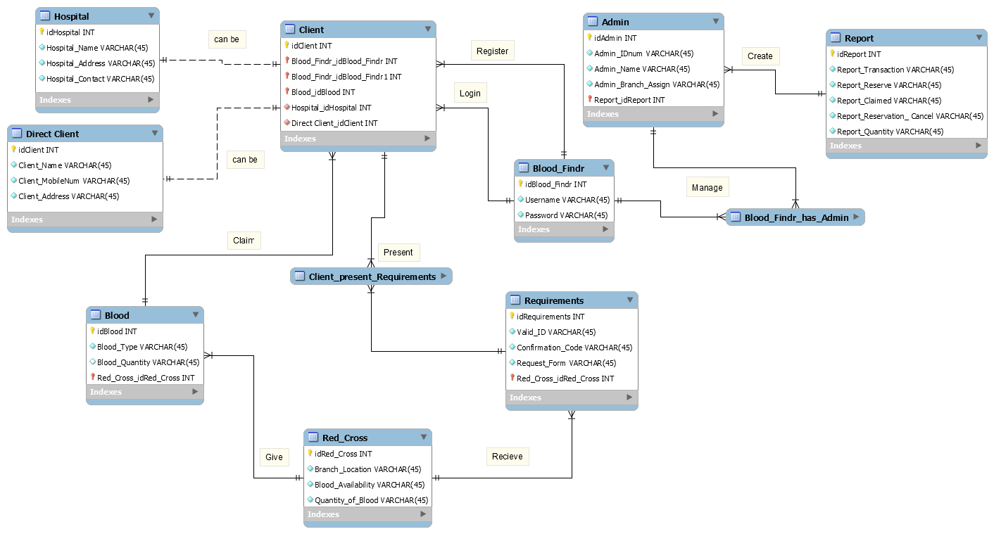
Entity Relationship Diagram:

Slide 18
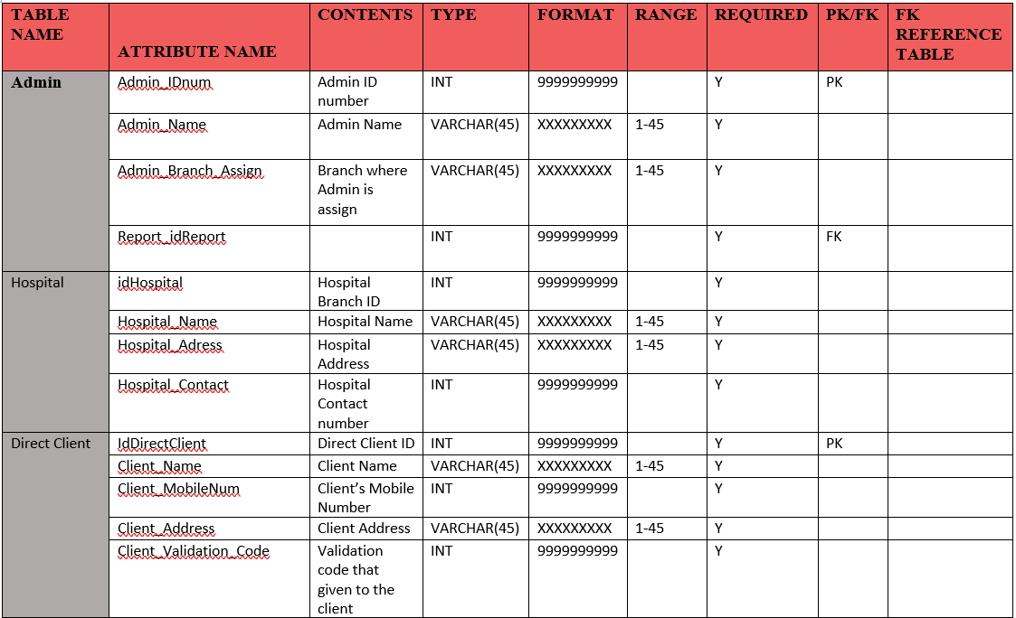
Data Dictionary:

Slide 19
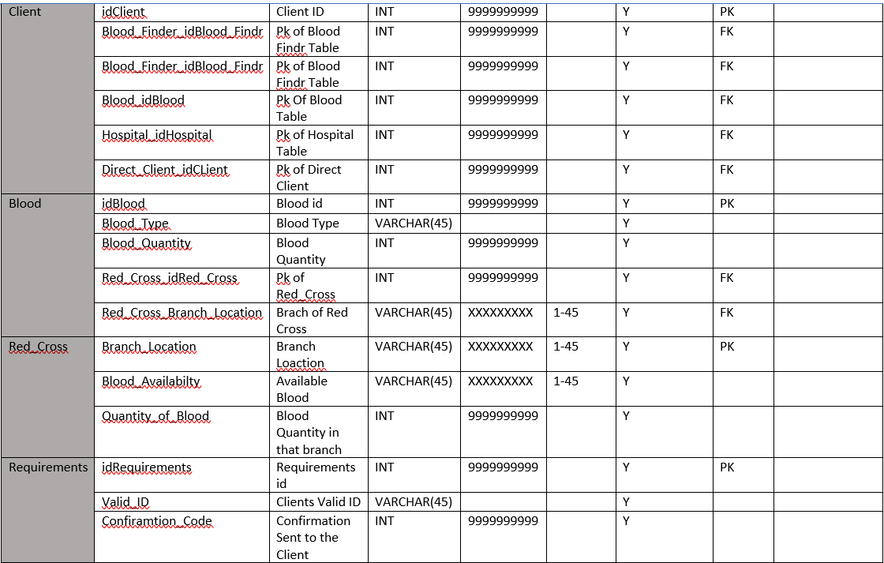
Data Dictionary (cont.):

Slide 20
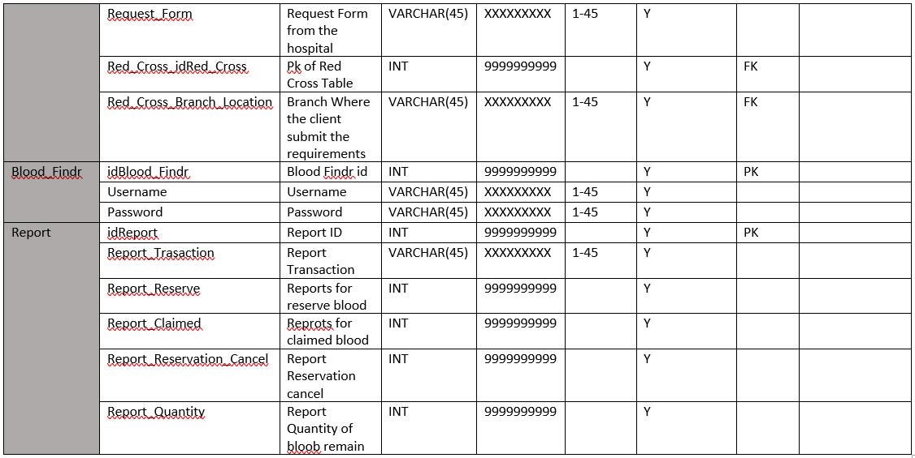
Data Dictionary (cont.):

Slide 21
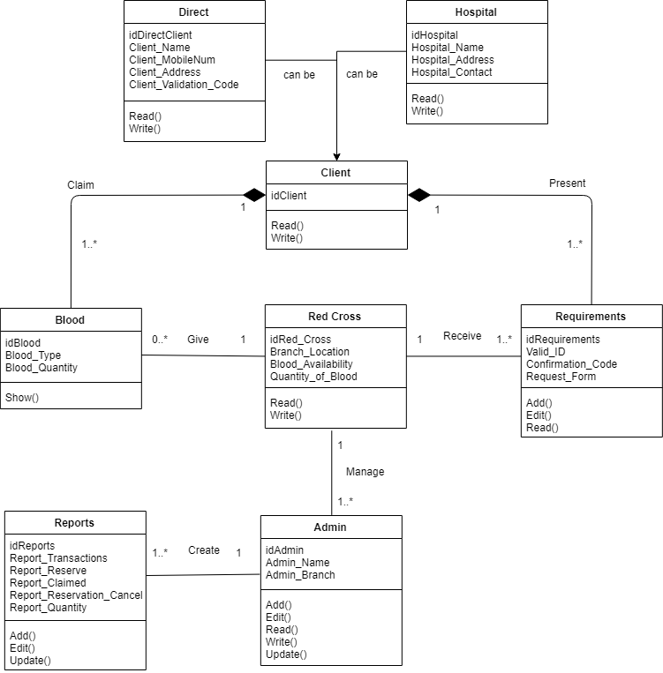
Class Diagram:

Slide 22
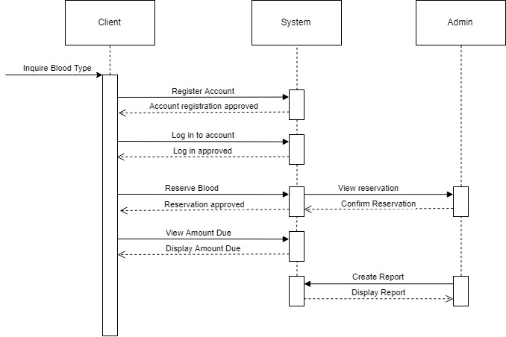
Sequence Diagram:

Slide 23
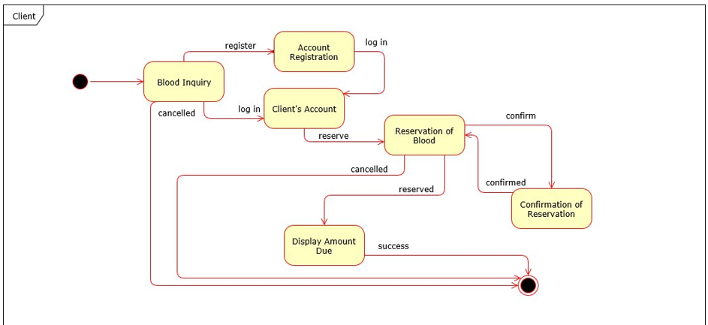
State Machine Diagram (Client):

Slide 24
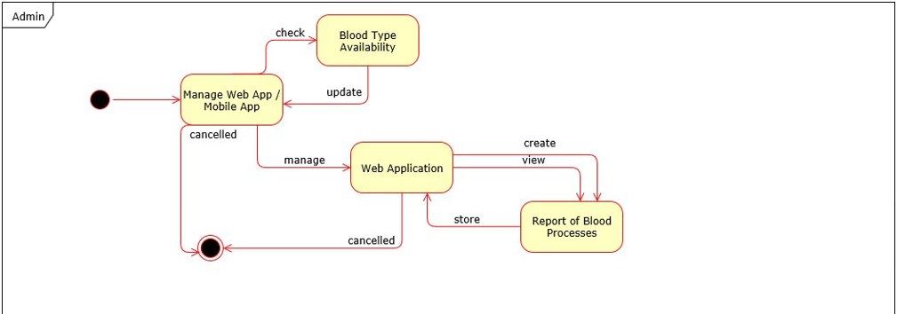
State Machine Diagram (Admin):

Slide 25
Conclusion:

